Slide 1
Symmetry Pairing Solutions
Presented by:
Gabe Hathorn CIMA®
Sr Regional Director
Symmetry Partners, LLC
For Advisor Use Only. Not for Public Distribution. Symmetry Partners, LLC, is an investment advisory firm registered with the Securities and Exchange Commission. The firm only transacts business in states where it is properly registered or excluded or exempted from registration requirements. No one should assume that future performance of any specific investment, investment strategy, product, or non-investment related content referred to directly or indirectly in this material will be profitable. As with any investment strategy, there is a possibility of profitability as well as loss. All data is from sources believed to be reliable but cannot be guaranteed or warranted. For additional information regarding Symmetry Partners, LLC please see disclosure at the end of this presentation labeled Important Information. Symmetry Partners is not affiliated with any firm mentioned in this material.
Notes:
Good morning/afternoon.
I’m Advisor’s Name and brief introduction
Thank you for taking the time to join me this morning/afternoon. Over the next hour or so, I’d like to discuss my thoughts on a unique approach to investing, and why I believe it may be critical to helping you reach your long-term goals.
Before we look at that, however, let’s take a look at why I believe that most investors can benefit when working with a professional financial advisor.

Slide 2
Symmetry – Strategic Core Pairings
Strategists fall within one of three different styles:
Strategic
Dynamic Manager
Tactical Manager
For Advisor Use Only. Not for Public Distribution.

Slide 3
Symmetry – Strategic Core Pairings
Strategic
  Asset Allocation Strategy
  Long-term focus
  Benefits:
    Tend to be broadly diversified
    Often more cost-effective
    More tax-efficient
  Popular managers that follow this style:
    Symmetry, Vanguard, Russell
For Advisor Use Only. Not for Public Distribution.

Slide 4

Our Investment Approach
The Best of Active & Passive
EVIDENCE-BASED
Rule-Based & Transparent
Factor, Risk & Behavioral Tilts
PASSIVE
ACTIVE
For Advisor Use Only. Not for Public Distribution.
Notes:
And one of the ways we do this is via an evidence-based investment philosophy that is neither passive nor active, but includes some of the best of these two approaches.
Passive: the funds are rule based and transparent
Active: the funds feature factor, risk and behavioral tilts.

Slide 5
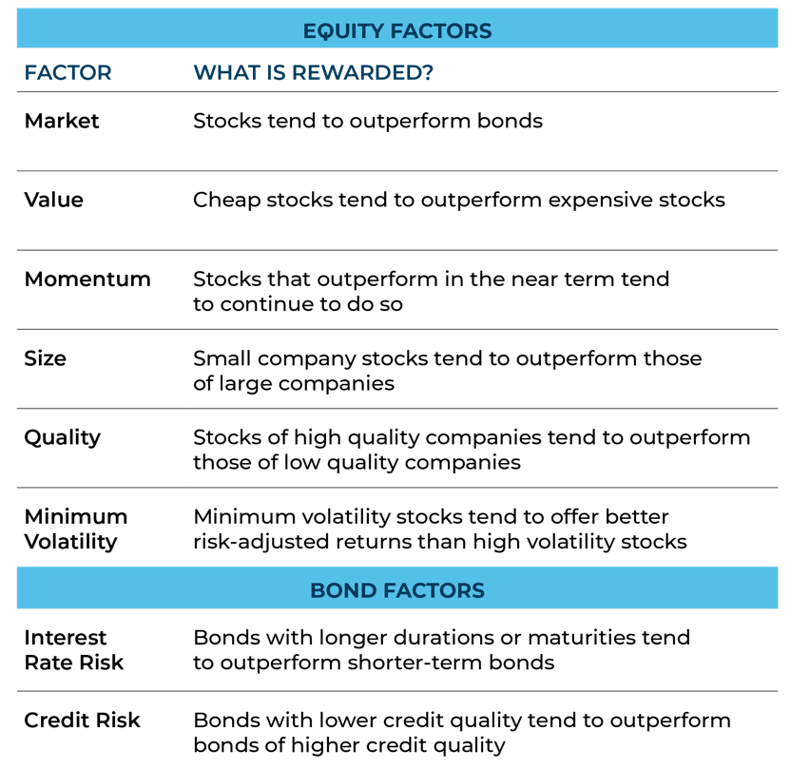
What Are Factors?
Factors are characteristics of stocks
or bonds, identified by extensive research,
that offer potential for:
Higher returns over time
Reduced risk*
Just as healthy diets depend on the right nutrients…portfolio returns depend largely
on the right factors.
*Please be advised that adding these factors may not ensure increased return over a market-weighted investment and may lead to underperformance relative to the benchmark over the investor’s time horizon. Information regarding these factors can be found on at the end of the presentation
Diversification seeks to improve performance by spreading your investment dollars into various asset classes to add balance to your portfolio. Using this methodology, however, does not guarantee a profit or protection from loss in a declining market.
Notes:
Read slide

Slide 6
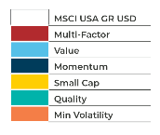
The Power of Factors & Diversification: Stocks
January 1, 2000 - December 31, 2022 (Annual Return %)
The chart above represents factor performance as illustrated by MSCI factor indices. They are representative of how single factors can vary in results and multi-factor can smooth out these variations.
Source: All returns from Morningstar. Annualized return is calculated as a geometric average to show what an investment would earn over a period of time if the annual return was compounded. For additional information regarding the limitations and description of the performance information, please see disclosure in the back.
Past performance does not guarantee future results. All data is from sources believed to be reliable but cannot be guaranteed or warranted. This piece is for conceptual understanding of factors only and does not reflect Symmetry’s actual factor implementation. Mutual Funds and ETFs chosen for Symmetry portfolios may not use these factor formulations.
Symmetry charges an investment management fee for its services. For detailed information about Symmetry Partners fees and expenses please see Symmetry Partners, LLC ADV part 2A located on the Symmetry website at www.symmetrypartners.com. As with any investment philosophy, there is a possibility of profitability as well as loss. Diversification seeks to reduce volatility by spreading your investment dollars into various asset classes to add balance to your portfolio. Please note that you should not assume that any discussion or information contained in this material serves as the receipt of, or as a substitute for, personalized investment advice from Symmetry Partners, LLC or your advisor.
Notes:
Previously, we mentioned that factors are sources of expected returns that have robust academic support.
The Diversification of Factors table illustrates, on a year-by-year basis, the positive or negative excess return contributions that various equity factors have provided with respect to a benchmark index. For example, in 2016, Small Cap stocks outpaced the benchmark by 8. 19% for the year, while Quality trailed the benchmark by 3.64%.

Slide 7
Symmetry – Strategic Core Pairings
Dynamic Manager
  Target Allocation Strategy
    Try to be opportunistic/defensive in current market environment
  Tend to have a global allocation but a higher US exposure
  May have more positions to adjust allocations
  More frequent rebalancing may lead to some tax-inefficiencies
  Popular managers that follow this style:
    Frontier, American Funds, BlackRock, Morningstar, Brinker, PGIM
For Advisor Use Only. Not for Public Distribution.

Slide 8
Symmetry – Strategic Core Pairings
Tactical Manager
  Downside protection to avoid giant losses (a la – 2008)
  Will move a large portion to cash
  More US focus. May provide Sector rotation strategies
  Big trades tend to lead to higher costs and are not tax-efficient
  Popular managers that follow this style:
    None currently on PSP
For Advisor Use Only. Not for Public Distribution.

Slide 9
Symmetry – Strategic Core Pairings
Strategic/Dynamic Manager
  Long-term asset allocation w/ dynamic shifts to be opportunistic/defensive
  Benefits combine rational & behavioral needs
  Pair Managers w/ complimentary allocations
  Managers to consider: BlackRock, Frontier
Strategic/Tactical Manager
  Long-term asset allocation w/ drawdown protection
  Managers to consider: Donoghue Forlines, Clark
For Advisor Use Only. Not for Public Distribution.

Slide 10

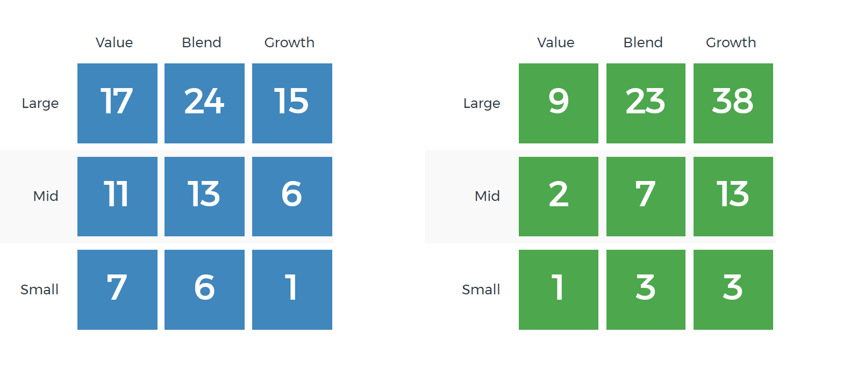
Symmetry Panoramic
Dynamic Manager
Benefits of Pairing
Complimentary Holdings
For Advisor Use Only. Not for Public Distribution.
Notes:
Read slide

Slide 11
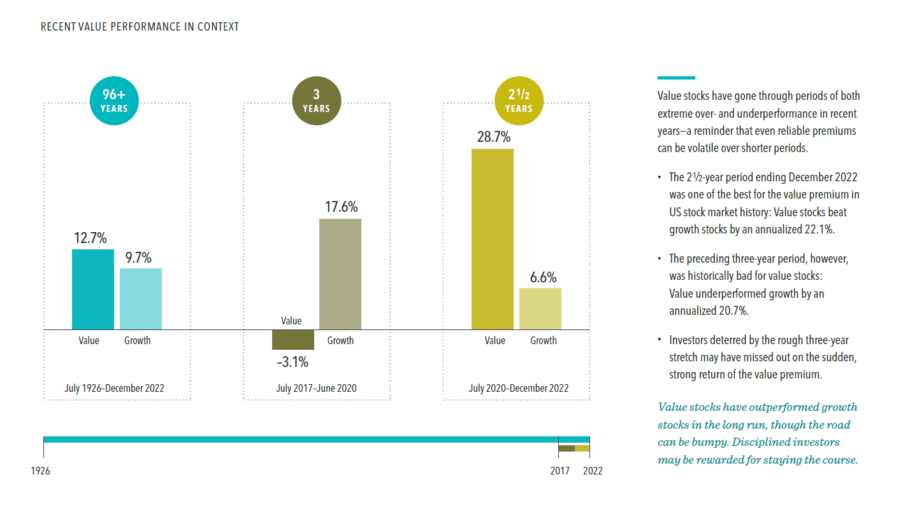
Styles Can Change Quickly

Slide 12
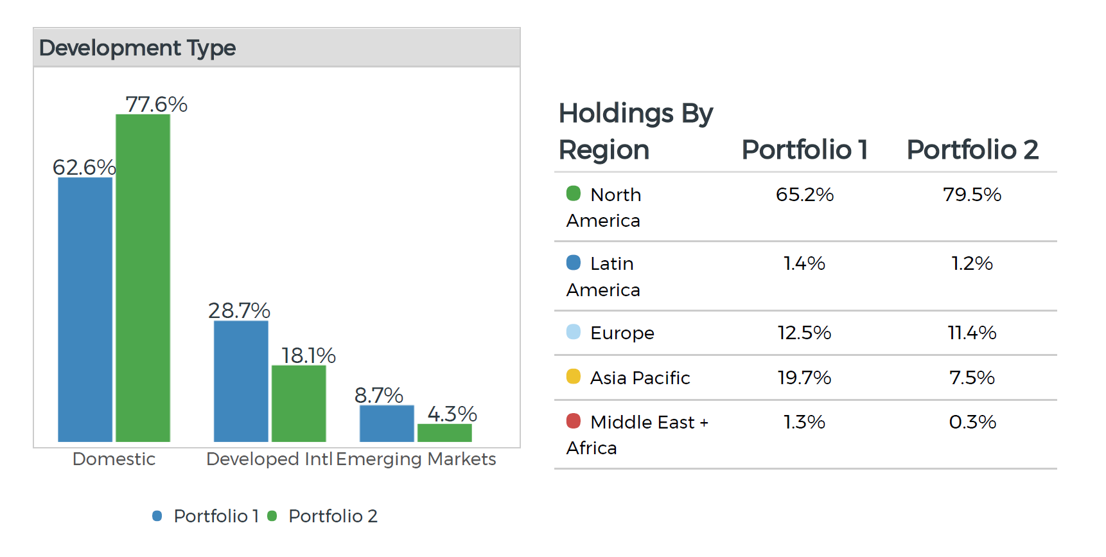
Benefits of Pairing
Geographic Weights
For Advisor Use Only. Not for Public Distribution.
Notes:
Read slide

Slide 13
Symmetry – PrecisionCore ETF Pairings
PrecisionCore ETF Portfolios pair well with SMA managers
  Long-term asset allocation beta portfolio with factor tilts
  High ex-US allocation (currently 45%)
  Most SMA managers excel in US (ex-US use mostly ADR)
  Adding SMA to PC brings up US allocation to desired level (70/30 for example)
  Similar cost structure
    Manager fee – 25 bps
    Expense Ratio – 14 bps
For Advisor Use Only. Not for Public Distribution.

Slide 14
Schedule a 30 Minute Webinar/Call with us to learn more
Visit www.symmetrypartners.com Sign up for access to My Symmetry
- our Advisor Portal
Gabe Hathorn
860-500-3503
800-786-3309 x2
ghathorn@symmetrypartners.com
Next Steps
For Advisor Use Only. Not for Public Distribution.
Notes:
Read slide

Slide 15

Thank You
“Scrappy,” the Symmetry bull is a symbol of our firm’s belief in the long-term power of markets.
For Advisor Use Only. Not for Public Distribution.
Notes:
Do you have any questions for me?

Slide 16

Important Information Symmetry Partners, LLC
Symmetry Partners, LLC is an investment advisory firm registered with the Securities and Exchange Commission. The firm only transacts business in states where it is properly registered, or exempted or excluded from registration requirements. Symmetry charges an investment management fee for its services. All Symmetry fees can be found in the Symmetry ADV Part2A located on the website at www.symmetrypartners.com. Past Performance does not guarantee future results. All data is from sources believed to be reliable but cannot be guaranteed or warranted. Any chart that is presented in this presentation is for informational purposes only and should not be considered an all inclusive formula for security selection. Different types of investments involve varying degrees of risk, and there can be no assurance that the future performance of any specific investment, investment strategy, or product, or any non-investment related content, made reference to directly or indirectly in this material will be profitable, or prove successful. As with any investment strategy, there is the possibility of profitability as well as loss. Due to various factors, including changing market conditions and/or applicable laws, the content may no longer be reflective of current opinions or positions.
Diversification seeks to reduce volatility by spreading your investment dollars into various asset classes to add balance to your portfolio. Using this methodology, however, does not guarantee a profit or protection from loss in a declining market. Rebalancing assets can have tax consequences. If you sell assets in a taxable account you may have to pay tax on any gain resulting from the sale. Please consult your tax advisor.
Any chart that is presented in this presentation is for informational purposes only and should not be considered an all inclusive formula for security selection.
Symmetry Partners’ investment approach seeks enhanced returns by overweighting assets that exhibit characteristics that tend to be in accordance with one or more “factors” identified in academic research as historically associated with higher returns. Please be advised that adding these factors may not ensure increased return over a market weighted investment and may lead to underperformance relative to the benchmark over the investor’s time horizon. The factors Symmetry seeks to capture may change over time at its discretion. Currently, the major factors in equity markets used by Symmetry and some associated academic research are: the market risk premium (Sharpe, William F. “Capital Asset Prices: A Theory of Market Equilibrium under Conditions of Risk.” The Journal of Finance, Vol. 19, No. 3 (Sept. 1964), 425-442.), value (Fama, Eugene and Ken French. “Common risk factors in the returns on stocks and bonds.” Journal of Financial Economics, 33, (1993), 3-56.), small (Banz, Rolf W. “The Relationship Between Return and Market Value of Common Stocks.” Journal of Financial Economics, 9 (1981), 3-18.), profitability (Novy-Marx, Robert. “The Other Side of Value: The Gross Profitability Premium.” Journal of Financial Economics, 108(1), (2013), 1-28. ), quality (Asness, Clifford S.; Andrea Frazzini; and Lasse H. Pedersen. “Quality Minus Junk.” Working Paper.), momentum (Jegadeesh,Narasimhan and Sheridan Titman. “Returns to Buying Winners and Selling Losers: Implications for Stock Market Efficiency.” The Journal of Finance, Vol. 48, No. 1, (March 1993), 65-91), and minimum volatility (Ang, Andrew, Robert J. Hodrick, Yuhang Xing and Xiaoyan Zhang. “The Cross-Section of Volatility and Expected Returns.” The Journal of Finance, Vol. 61, No. 1 (Feb. 2006), pp. 259-299.) On the bond side, Symmetry primarily seeks to capture maturity and credit risk premiums (Ilmanen, Antti. Expected Returns: An Investor’s Guide to Harvesting Market Rewards. WileyFinance, 2011, p157-158 and 183-185.). All data is from sources believed to be reliable but cannot be guaranteed or warranted.

Slide 17
Important Information Symmetry Partners, LLC
Higher potential return generally involves greater risk, short term volatility is not uncommon when investing in various types of funds including but not limited to: sector, emerging markets, small and mid-cap funds. International investing involves special risks such as currency fluctuation, lower liquidity, political and economic uncertainties, and differences in accounting standards. Risks of foreign investing are generally intensified for investments in emerging markets. Risks for emerging markets include risks relating to the relatively smaller size and lesser liquidity of these markets, high inflation rates and adverse political developments. Risks for investing in international equity include foreign currency risk, as well as, fluctuation due to economic or political actions of foreign governments and/or less regulated or liquid markets. Risks for smaller companies include business risks, significant stock price fluctuation and illiquidity. Investing in real estate entails certain risks, including changes in: the economy, supply and demand, laws, tenant turnover, interest rates (including periods of high interest rates), availability of mortgage funds, operation expenses and cost of insurance. Some real estate investments offer limited liquidity options. Investing in higher-yielding, lower-rated bonds has a greater risk of price fluctuation and loss of principal income than U.S. government securities, such as U.S. Treasury bond and bills. Treasuries and government securities are guaranteed by the government for repayment of principal and interest if held to maturity. Investors should carefully assess the risks associated with an investment in the fund
DIFFERENT TYPES OF INVESTMENTS AND/OR INVESTMENT STRATEGIES INVOLVE VARYING LEVELS OF RISK, AND THERE CAN BE NO ASSURANCE THAT ANY SPECIFIC INVESTMENT OR INVESTMENT STRATEGY WILL BE EITHER SUITABLE OR PROFITABLE FOR YOUR PORTFOLIO. Allocation models are not intended to represent investment advice that is appropriate for all investors. Each investor must take into account his/her financial resources, investment goals, risk tolerance, investing time horizon, tax situation and other relevant factors to determine if such portfolio is suitable. Model composition is subject to change. You and your advisor should carefully consider your suitability depending on your financial situation. As with any investment there may be tax consequences. The holdings comprising the strategies and the allocations to those holdings have changed over time and may change in the future. Symmetry tax-managed portfolios are designed with the goal of increasing the portfolio’s overall tax efficiency. Changes to portfolio holdings which comprise the portfolio may have tax consequences. If you sell assets in a taxable account, you may have to pay tax on any gain. While Symmetry seeks to mitigate tax exposure when possible, it is likely that investors will incur a taxable event while being invested in the portfolio.
© Morningstar 2019. All rights reserved. The information contained herein: (1) is proprietary to Morningstar and/or its content providers; (2) may not be copied, adapted or distributed; and (3) is not warranted to be accurate, complete or timely. Neither Morningstar nor its content providers are responsible for any damages or losses arising from any use of this information, except where such damages or losses cannot be limited or excluded by law in your jurisdiction. Past financial performance is no guarantee of future results.

Slide 18
Notable Research
QMJ (Quality minus Junk) or Quality Factor is constructed as the intersection of six value-weighted portfolios formed on size and quality. The factor is long the top 30% high-quality stocks and short the bottom 30% junk stocks within the universe of large stocks and similarly within the universe of small stocks.
Sharpe: Bill Sharpe, Professor of Finance Emeritus at Stanford University Graduate School of Business, and winner of the Nobel Prize in Economics in 1990. Known for his work on the Capital Asset Pricing Model.
Banz: Rolf Banz, published “The Relationship Between Return and Market Value of Common Stocks” in 1981 showing the higher return on small cap stocks than large.
Fama and French: Eugene Fama, Robert R. McCormick Distinguished Service Professor of Finance at the University of Chicago and Kenneth R. French, Roth Family Distinguished Professor of Finance at the Tuck School of Business at Dartmouth. Known for their work on value and small cap premiums and the “Fama-French Three-Factor Model.”
Basu: S. Basu, published “Investment Performance of Common Stocks in Relation to their Price-Earnings Ratio: A Test of the Efficient Market Hypothesis,”in 1977 regarding value stocks.
Novy-Marx, Robert. “The other side of value: The gross profitability premium.” Journal of Financial Economics, 2013.
Asness, Clifford S.; Andrea Frazzini; and Lasse H. Pedersen. “Quality Minus Junk.” Working Paper.
Jegadeesh, Narasimhan and Sheridan Titman. “Returns to Buying Winners and Selling Losers: Implications for Stock Market Efficiency.” The Journal of Finance, 1993.
Ang, Hodrick, Xing and Zhang. “The Cross-Section of Volatility and Expected Returns.” The Journal of Finance, 2006.
Yakov Amihud of Tel Aviv University and Haim Mendelson of University of Rochester, for their work on liquidity.
Longstaff, Francis A. and Eduardo S. Schwartz. “A Simple Approach to Valuing Risky Fixed and Floating Rate Debt.” The Journal of Finance, 1995.
Merton: Robert C. Merton, published “On the Pricing of Corporate Debt: The risk structure of interest rates,” in the Journal of Finance in 1974.
Elton, Gruber, Agrawal, and Mann: Edwin J. Elton, Martin J. Gruber, Deepak Agrawal and Christopher Mann published “Explaining the rate spread on corporate bonds,” in the Journal of Finance in 2001.
Ilmanen, Antti. Expected Returns: An Investor’s Guide to Harvesting Market Rewards. Wiley, 2011, pp. 157-158 and pp. 183-185 for other fixed income factor references.
Stanley Fischer. “The Demand for Index Bonds,” Journal of Political Economy, Volume 83 (June 1975), pp. 509-534.

Slide 19
Poor Track Record for Active Managers Disclosure
Diversification seeks to reduce volatility by spreading your investment dollars into various asset classes to add balance to your portfolio. Using this methodology, however, does not guarantee a profit or protection from loss in a declining market. Rebalancing assets can have tax consequences. If you sell assets in a taxable account you may have to pay tax on any gain resulting from the sale. Please consult your tax advisor.
Different types of investments and/or investment strategies involve varying levels of risk, and there can be no assurance that any specific investment or investment strategy will either be suitable or profitable for your portfolio. You and your advisor should carefully consider your suitability depending on your situation.
Past performance is no guarantee of future results. Data courtesy of Standard & Poor’s Index Versus Active (SPIVA) report as of 12/31/19. The SPIVA Scorecard presents the performances of actively managed mutual funds as compared to benchmark indices. It covers U.S. equity, international equity and fixed income categories. Percentages represent the percent of the equal-weighted asset class that is outperformed by its relative benchmark as defined below.
All indexes have certain limitations. Investors cannot invest directly in an index. Indexes have no fees. Historical performance results for investment indexes generally do not reflect the deduction of transaction and/or custodial charges or the deduction of an investment management fee, the incurrence of which would have the effect of decreasing historical performance results. Actual performance for client accounts may differ materially from the index portfolios. The SPIVA comparison is made against the “average” active manager performance. Investors cannot invest in the “average active manager.”
•S&P 500 Index: Widely regarded as the best single gauge of the U.S. equities market, this market capitalization-weighted index includes a representative sample of 500 leading companies in leading industries of the U.S. economy and provides over 80% coverage of U.S. equities.
• S&P SmallCap 600 Index: This index consists of 600 small-cap stocks and covers approximately 3% of the U.S. equities market.
• S&P International 700 Index: This index measures the non-United States component of the global equity markets. The index covers all of the regions included in the S&P Global 1200 except for the United States (S&P 500).
• S&P Composite 1500 Value: An index of US stocks made by Standard & Poor’s. It includes all stocks in the S&P 500, S&P 400, and S&P 600. This index covers 90% of the market capitalization of U.S. stocks.
•S&P/IFCI Composite Index: This index is widely recognized as a comprehensive and reliable measure of the world’s emerging markets. It measures the returns of stocks that are legally and practically available to foreign investors.
• Barclays US Government (1-3 Year) Index: measures the performance of the US government bond market and includes public obligations of the U.S. Treasury with a maturity between 1 and up to (but not including) 3 years.
•Barclays Global Aggregate Bond Index: a flagship measure of global investment grade debt from twenty-four local currency markets. This multi-currency benchmark includes treasury, government-related, corporate and securitized fixed-rate bonds from both developed and emerging issuers.
For further information regarding Standard and Poor’s Indices Versus Active Funds Scorecard, please go to https://us.spindices.com/documents/spiva/spiva-us-year-end-2019.pdf.

Slide 20
The Power of Factors & Diversification - Stocks Disclosure
Factors are sources of expected returns. Symmetry searches for factors that have been shown historically to deliver higher returns over time. Symmetry Partners’ investment approach seeks enhanced returns by overweighting assets that exhibit characteristics that tend to be in accordance with one or more “factors” identified in academic research as historically associated with higher returns. Please be advised that adding these factors may not ensure increased return over a market weighted investment and may lead to underperformance relative to the benchmark over the investor’s time horizon.
Historical performance results for investment indices and/or categories have been provided for general comparison purposes only, and generally do not reflect the deduction of transaction and/or custodial charges, the deduction of an investment management fee, nor the impact of taxes, the incurrence of which would have the effect of decreasing historical performance results. It should not be assumed that your account holdings correspond directly to any comparative indices.
All indexes have certain limitations. Investors cannot invest directly in an index. Indexes have no fees. Historical performance results for investment indexes generally do not reflect the deduction of transaction and/or custodial charges or the deduction of an investment management fee, the incurrence of which would have the effect of decreasing historical performance. The index performance includes the reinvestment of dividends of the underlying securities. Actual performance for client accounts may differ materially from the index portfolios.
Value = MSCI USA Value Index: MSCI USA Value Index captures large and mid-cap US securities exhibiting overall value style characteristics. The value investment style characteristics for index construction are defined using three variables: book value to price, 12-month forward earnings to price and dividend yield. With 322 constituents, the index targets 50% coverage of the free float-adjusted market capitalization of the MSCI USA Index.
Quality = MSCI USA Quality Index: MSCI USA Quality Index is based on the MSCI USA Index, its parent index, which includes large and mid-cap stocks in the US equity market. The index aims to capture the performance of quality growth stocks by identifying stocks with high quality scores based on three main fundamental variables: high return on equity (ROE), stable year-over-year earnings growth and low financial leverage.
Momentum = MSCI USA Momentum Index: MSCI USA Momentum Index is based on MSCI USA Index, its parent index, which captures large and mid-cap stocks of the US market. It is designed to reflect the performance of an equity momentum strategy by emphasizing stocks with high price momentum, while maintaining reasonably high trading liquidity, investment capacity and moderate index turnover.
Small-Cap = MSCI USA Small Cap Index: MSCI USA Small Cap Index is designed to measure the performance of the small cap segment of the US equity market. With 1,864 constituents, the index represents approximately 14% of the free float-adjusted market capitalization in the US.
Multi-Factor = MSCI USA Diversified Multiple-Factor Index: MSCI USA Diversified Multiple-Factor Index is based on a traditional market cap weighted parent index, the MSCI USA Index, which includes US large and mid-cap stocks. The index aims to maximize exposure to four factors – Value, Momentum, Quality and Low Size -- while maintaining a risk profile similar to that of the underlying parent index.
Min-Volatility = MSCI USA Minimum Volatility Index: MSCI USA Minimum Volatility Index aims to reflect the performance characteristics of a minimum variance strategy applied to the large and mid-cap USA equity universe. The index is calculated by optimizing the MSCI USA Index, its parent index, in USD for the lowest absolute risk (within a given set of constraints). Historically, the index has shown lower beta and volatility characteristics relative to the MSCI USA Index.
MSCI USA = MSCI USA GR USD: which is designed to measure the performance of the large and mid cap segments of the US market. With 622 constituents, the index covers approximately 85% of the free float-adjusted market capitalization in the US.
The MSCI ACWI Diversified Multiple-Factor Index is based on MSCI ACWI Index, its parent index, which includes large and mid cap stocks across 23 Developed Markets (DM) and 26 Emerging Markets (EM) countries*. The index aims to maximize exposure to four factors – Value, Momentum, Quality and Low Size -- while maintaining a risk profile like that of the underlying parent index.
© Morningstar 2020. All rights reserved. The information contained herein: (1) is proprietary to Morningstar and/or its content providers; (2) may not be copied, adapted or distributed; and (3) is not warranted to be accurate, complete or timely. Neither Morningstar nor its content providers are responsible for any damages or losses arising from any use of this information, except where such damages or losses cannot be limited or excluded by law in your jurisdiction. Past financial performance is no guarantee of future results.

